Slide 1
MedMen Analysis
By Matthew Yee

Slide 2
Technology and Tools Used
Python Pandas to read, create, manipulate, merge and summarize data.
Merged all data sheets from excel spreadsheet as well as grouped data by Month and Week.
Python Plotly to graphically represent data.
Graphs and charts all have hyperlinks that can be followed to see interactive graphs.
Actual code and repository can be found here.

Slide 3
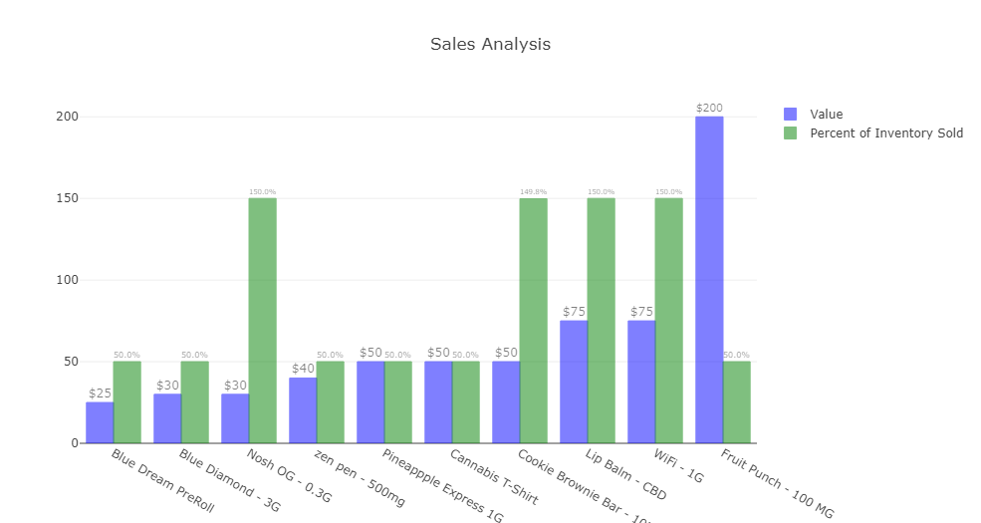
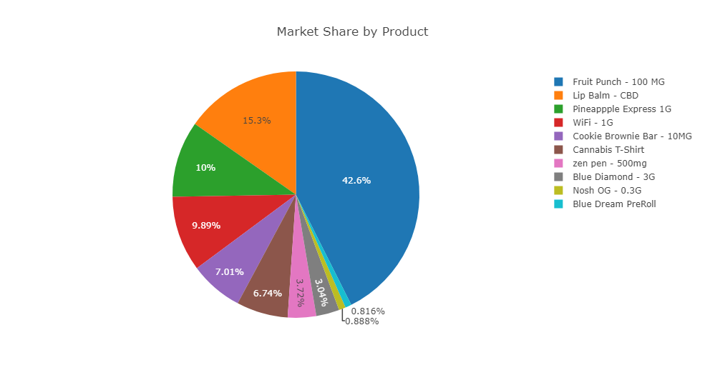
Sales
Over the past years, we have sold approximately 50% of our starting inventory for the following products: Blue Dream Roll, Blue Diamond, zen pen, Pineapple Express, Cannabis T-Shirt, and Fruit Punch, while we have sold approximately 150% of our starting inventory Nosh OG, Cookie Bar Brownie, Lip Balm – CBD and WiFi.
The products that have sold 150% have our highest turnover and we should work to market these, as well as potentially use these to drive future sales.
Fruit Punch accounts for 42.6% of our revenue. While some of this has to do with the cost of Fruit Punch ($200), this is concerning. Since the cost is so high, if something happened to the economy or demand went down, sales and revenue may drop significantly. We should try to diversify our sales and spread out our revenue across more product offerings to provide more balance.
We have a big pricing jump from $75 to $200 for a product, may be nice to have some products with a price point in between these two.
Notes:
Product Line Mix, need to diversify sales. Need to maybe add products at a price point between $75 and $200.

Slide 4
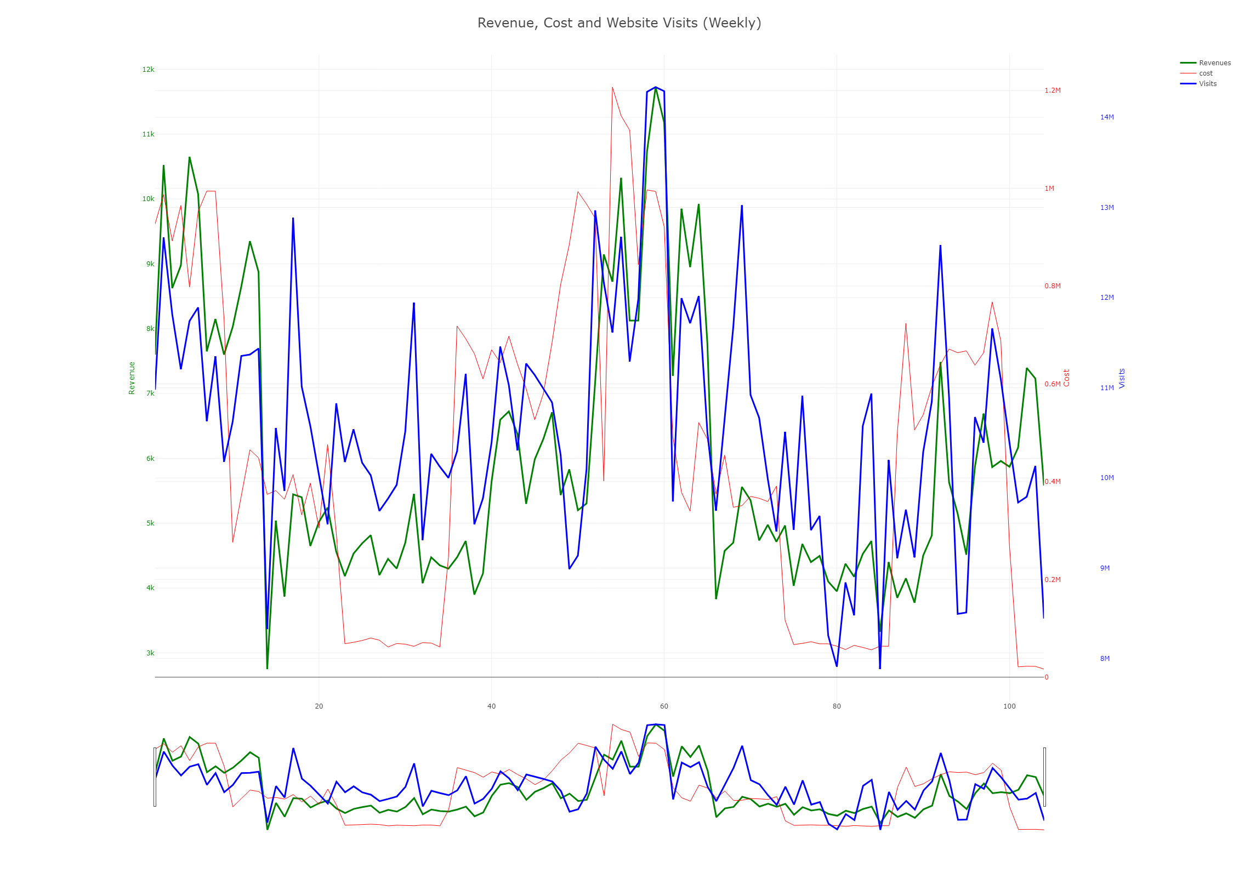
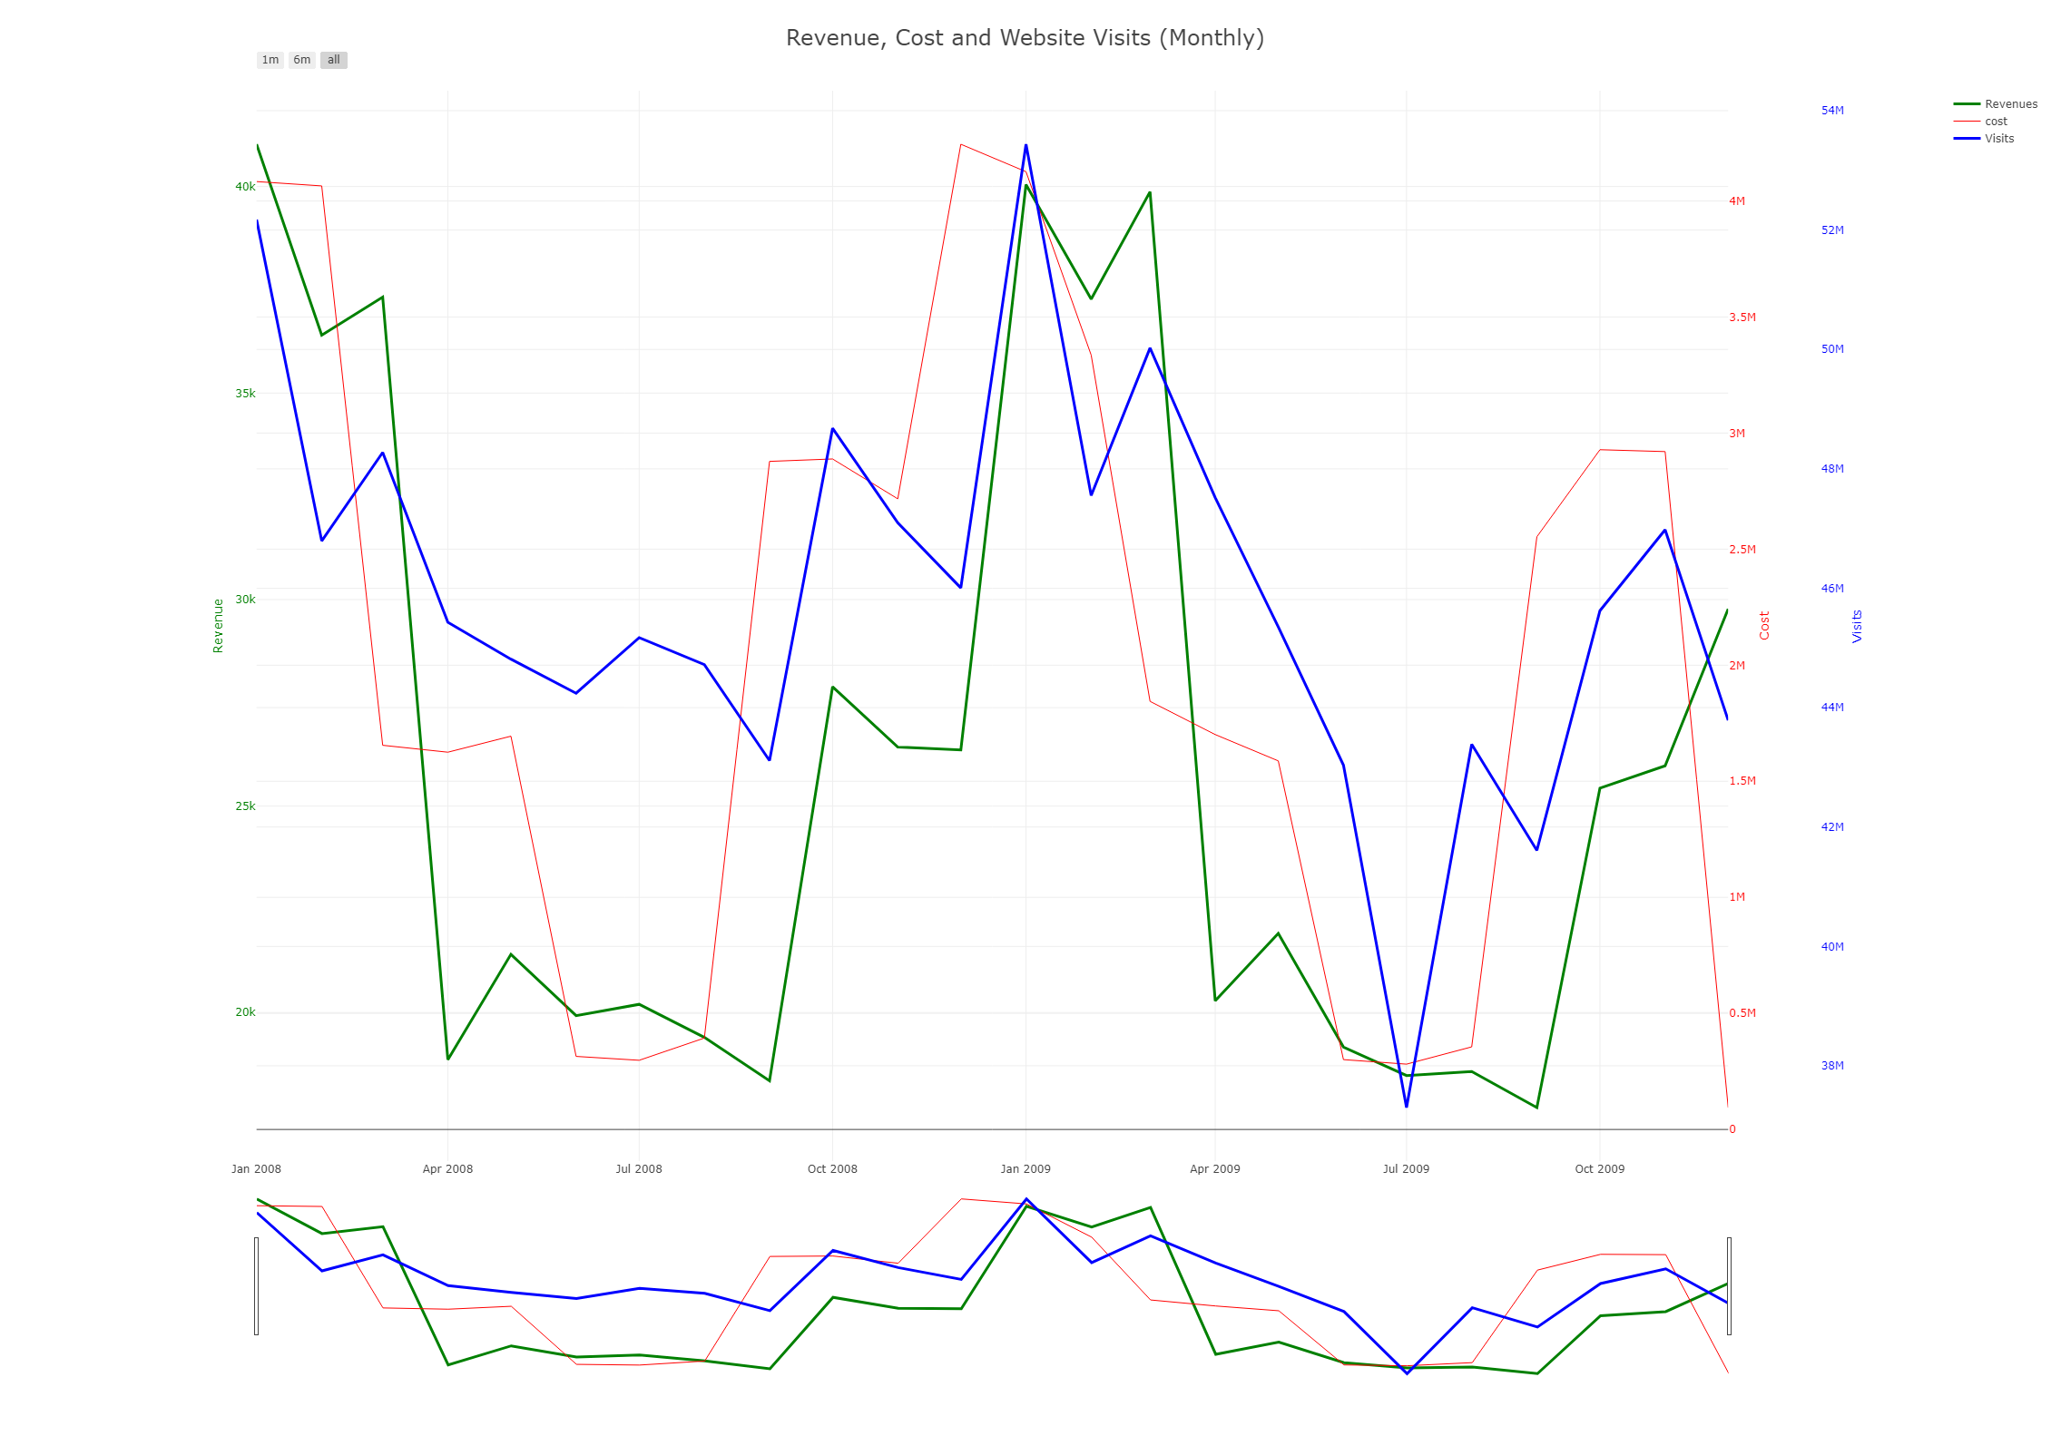
Marketing Effects on MedMen
The Weekly and Monthly Marketing Costs (Red Lines) seems to be an indicator for Website Visits (Blue Lines) and Revenue Generated (Green Lines). Although the magnitude of the change may be different, ultimately, when we drop our marketing costs, our sales and traffic go down, and vice versa.
This seem to indicate the when MedMen spends money on marketing campaigns, people go to the MedMen website and more importantly, people buy our products.
We seem to have lulls in our marketing during July each year, which looks like it may lead to a decrease in website traffic and ultimately a dip in sales.
Ultimately, I think we’d like to see more balance in our sales year round and generate more consistent sales numbers rather than the peaks and valleys that we see in our revenue streams.
Notes:
Our total marketing costs are aggregated by the red line. You can see that the blue and green lines, the website traffic and the revenue generated seems to trail the cost. This suggests that when we have marketing campaigns, the spikes in the red, we generate more sales in the coming weeks and months following the marketing effort. That being said, we seem to have low points, each year around summer months. While I think its okay to have some drop, the amount of drop is staggering and it severely reduces our sales in the summer months and then affects our business as it tries to generate momentum in the upcoming months. I’d recommend having a more consistent approach with fewer valleys and peaks in marketing spending to drive more consistent and higher revenues.
The other good thing to point out is that it looks like our customers are buying when they reach the market. The blue line and green line seem to follow very similar trajectories, meaning the traffic generated at our website, is leading to a proportional amount of sales.

Slide 5
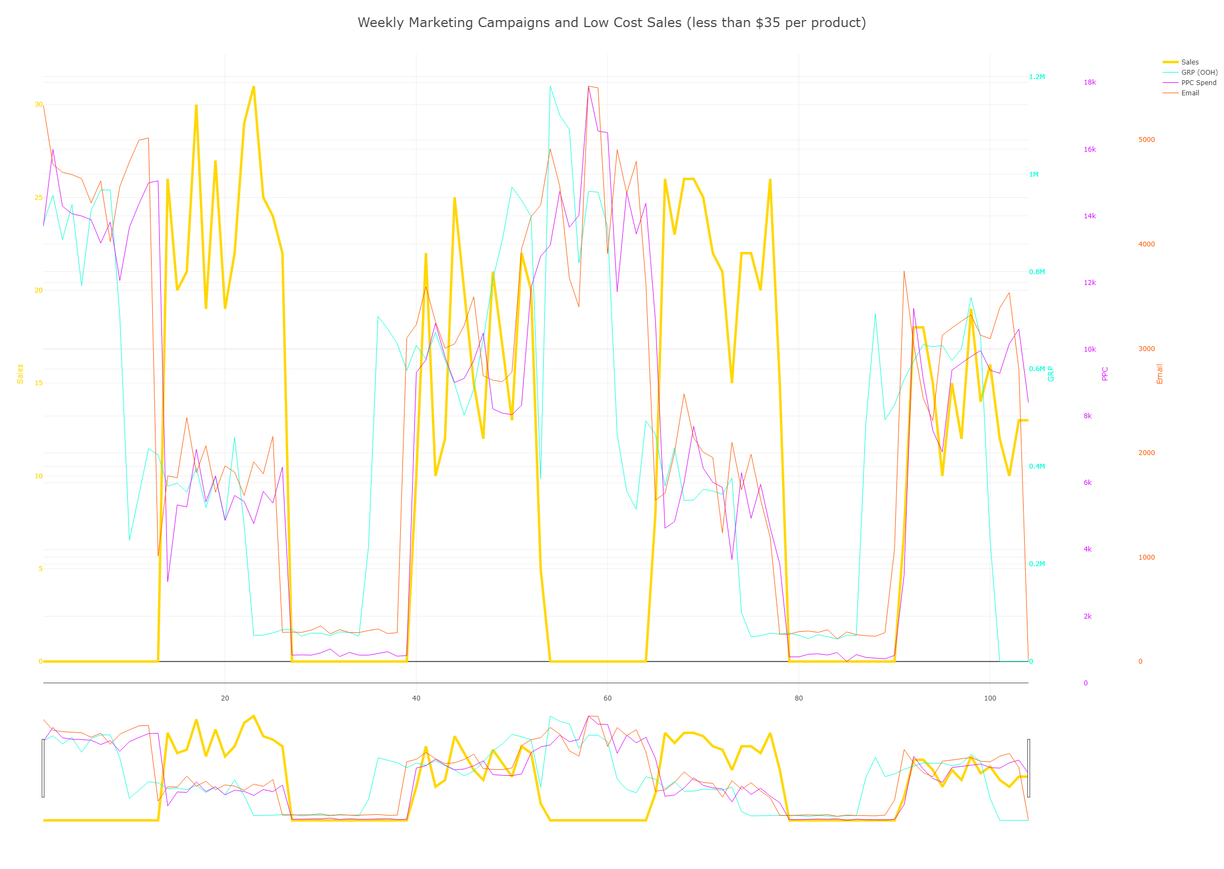
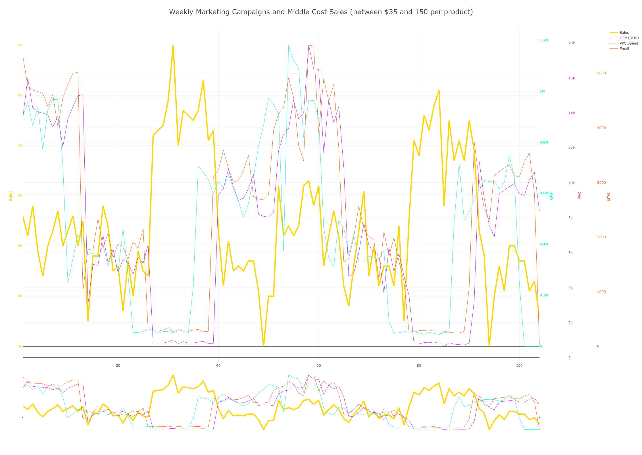
Marketing Effects on Low and Medium Cost Options
Tiered the product by price (Low is less than $35, Medium is between $35 and $150, and high is anything over $150)
Our Sales for Low-Cost and Medium-Cost products seem to complement each other
Low Cost Sales seem to be quarterly suggesting we have sales on the low-cost options quarterly. While sales in the medium price range have sales each week, the actual sale count fluctuates based on the whether low-cost option are available.
Marketing Costs seem to drive the number of sales in the low-cost market, when the products are available for sale.
Marketing Costs also seem to drive Medium Cost Sales, but only when both Low Cost and Medium Cost Options are available. When low cost options are not available, the number of sales for medium priced options actually increases, regardless of whether or not we market the products.
The quarterly sales may be too long. I’d suggest making the sale for a shorter duration, maybe a month, to continue to drive high sales numbers and price per sale in the medium market with less focus on the low-cost market and sales.
Notes:
Addresses Supply and Demand. Demand seems to be higher overall for the medium cost products. Even when the lower cost option is available, the middle cost option still sells its fair share. I think we see some instances of cannibalism between our products. I think our focus should be more on cultivating and nurturing the middle market while still continuing to have sales. The sales I think can be helpful to get new clients and customers buying our products but amount of time that we make the low cost option available to the public can be decreased. This will overall increase the number of sales for the middle cost sales, which is a more desirable sale from a revenue standpoint for our business.

Slide 6
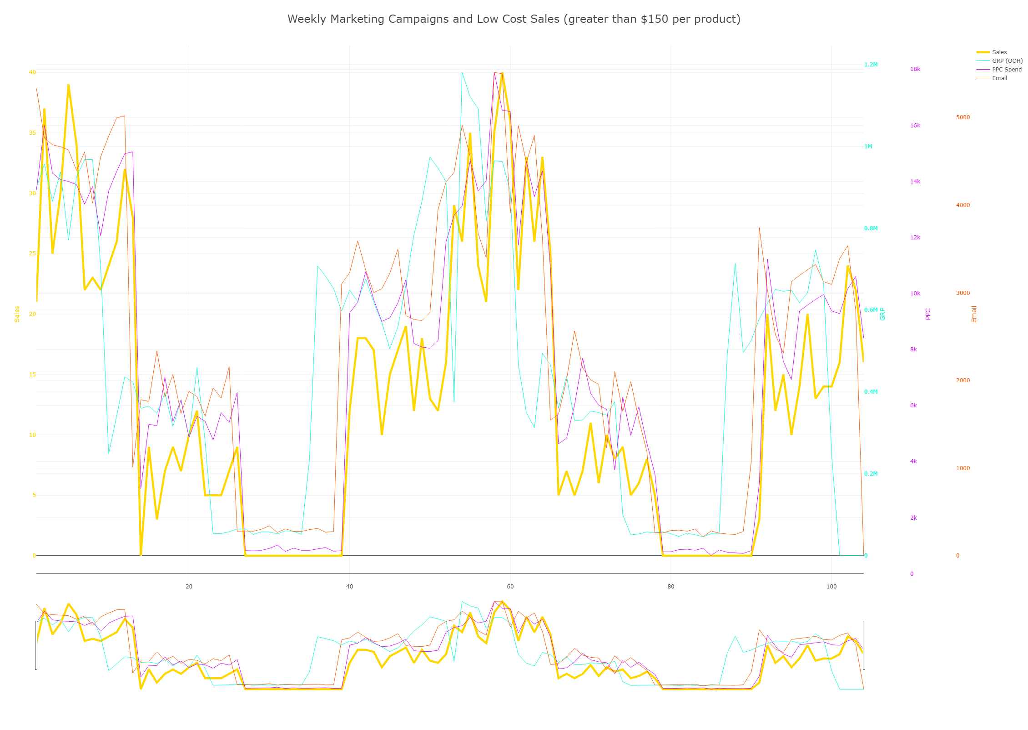
Marketing Effects on High Cost Options
For our High Cost Options, we follow a spending trend with our Marketing costs. First, we spend on OOH marketing, then on Email Campaigns, then PPC Advertising and then the consumer buys the product. Although not pictured here, Direct Marketing varies in a much different pattern.
Revenue patterns for the high cost products follows the marketing spending most closely of the three product tiers.
Because of this pattern, it makes it tough to tell if one of the marketing avenues is actually leading to the consumer buying the product.
It may be beneficial to decrease the spending on the OOH Marketing costs, since this cost is dramatically higher (ranges include OOH ~$50k to $1.2M per week vs. PPC $500 to $18k per week vs. $100 to $6000 per week).
If the same results or near the same results can be achieved by reducing the OOH spending, in total, the profits should increase given that we will be spending less but still bringing in close to the same amount of revenue on our high cost products.

Slide 7
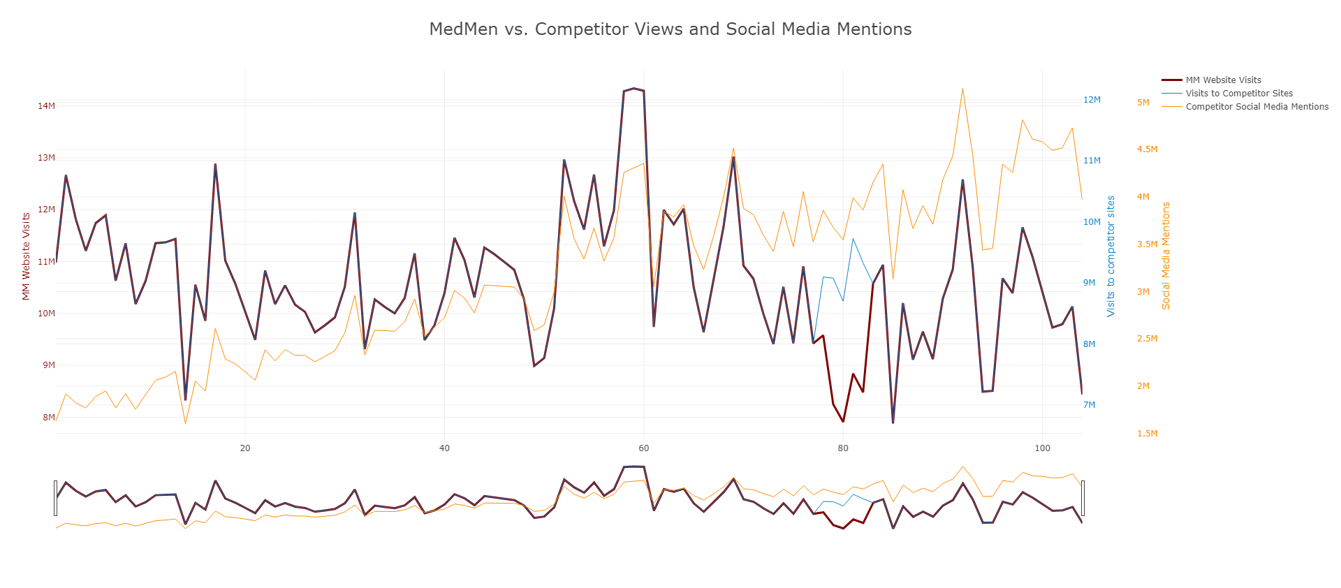
MedMen vs. Competitor Views and Social Media Mentions
We’ve established that our marketing campaigns leads to page views and that page views leads to sales. This chart shows competitor sites have similar view patterns for their website although MedMen level of views is slightly higher.
This shows that perhaps our marketing is leading to views across the industry and that maybe consumers are shopping across all sellers when they see our marketing campaigns.
It may be beneficial to cut back on our marketing some and see if we can also “piggy back” off competitors marketing.
Interestingly, our Competitor’s Social Media Mentions seem to be steadily trending upward despite the different trend in website viewership for MedMen and our competitors.

Slide 8
Conclusions
While our media spending is shown to lead to more web traffic and eventually to sales, we are currently spending a lot to do this, especially the OOH Media Spending. With so many media campaigns underway, its not clear which media campaign is the driver for sales, since all our outlets have similar cost trends. It may be beneficial to reduce some of the OOH spending and see if we can produce similar results with decreased levels in marketing spending.
Our marketing leads to High Value Sales, but the Lower and Middle Cost Sales don’t follow our marketing spending trends as closely.
When we offer lower cost option, people tend to buy them, instead of the more expensive middle cost option. We seem to offer the lower cost option every other quarter. This may be to introduce ourselves to new clients who may just want to test out the products. It may be beneficial to instead offer a sale for a month, instead of the whole quarter so as not to cannibalize our own revenues with cheaper, less profitable products.
Product offerings has some gaps. We only have options below $75 and at $200. We don’t have options in between. It may be nice for some consumers to have an option that they can use in between.
Additionally, the Fruit Punch Product ($200), accounts for nearly half of our revenues. This can be dangerous for us because if something happens to the product (a disease in the plant, a fire, or a recession that makes the product unaffordable), we could see a severe drop in our revenues. It may be better to expand our product offerings and add more affordable options.
Compared to starting inventories, our middle tier priced option, especially at the $40-75 range, seems to sell more than our starting inventory more often than the other ranges. We should focus on what makes us sell these products and continue to expand in this industry.

